Slide 1
Course Name: Artificial Intelligence Laboratory Course No.: CSE4110 Presentation on EatBest Game Presented to: Abdul Aziz Assistant Professor, CSE, KUET & S. M. Taslim Uddin Raju Lecturer, CSE, KUET
Presented by:
Nohel Kumar Nath (1607013)
Md. Noyan Ali (1607021)
Shahriar Hossain Shanto (1607023)

Slide 2
Game Description
Collection of different types of fruit . Each fruit has a predefined calorie and weigh
Randomly 5 fruits will be selected for each player
Player can consume up to total 1000g fruit
Human can choose the fruits using his intelligence
Computer will choose the fruits using 0/1 Knapsack algorithm
After 5 turns scores will be evaluated
High scorer will be winner

Slide 3
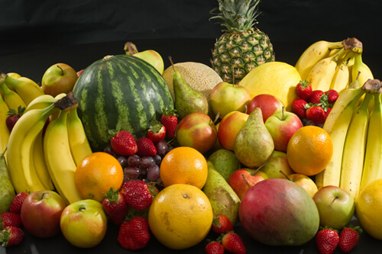

Game Description (Con…)
Collection of different fruits. Each fruit has it’s weight and calorie.
Randomly selected 5 fruits from collection of fruits.
Randomly selected 5 fruits from collection of fruits.
Player
Computer

Slide 4
Fruits Table
Table 1: Fruit Table with weight and calorie
Fruit Name | Weight (g) | Calorie
Mango | 200 | 150
Apple | 100 | 225
Banana | 50 | 200
Guava | 100 | 150
And So On…

Slide 5
Flowchart of Game
Start
Initialize Turn (T), Weight (W) & Score (S) [T = W = S = 0]
W or T exceed
Compare Score
Check W & T
Lose
Find Maximum Calorie / Weight
Win
Update W, S & T
Show W, S & T

Slide 6
Let’s Play
Table 2 : Table of fruits with Calorie / Weight
Fruit Name | Weight (g) | Calorie | Calorie/ Weight
A | 100 | 200 | 2
B | 50 | 150 | 3
C | 100 | 100 | 1
… | … | … | …
First Turn:
After choosing fruit:
Player1
Computer
Player1
Computer
A
B
C
T = 1
W = S = 0
Amount : 500g
A
B
C
T = 1
W = S = 0
Amount : 500g
T = 1
W = 50
S = 150
Amount : 450g
T = 1
W = 50
S = 150
Amount : 450g

Slide 7
Result Evaluation
At the end :
Computer is Winner!
Player 1
Turn = 5
Score = 450
Remaining Amount = 30 g
Computer
Turn = 5
Score = 600
Remaining Amount = 5 g

Slide 8
Question
Any Question ?

Slide 9
The End
Thanks

